Slide 1

SLAMS-Self Learning Automated Monitoring System IIT Roorkee
4th INTER-IIT Tech Meet 2016
January 30th, 2016
YASH GANGRADE SUVANSH KUMAR AMIT MANCHANDA SHAURYA ANAND SWABHIMAN PATNAIK

Slide 2

Outline
Prerequisite Skills
Introduction to IoT and Smart Home
What is SLAMS?
Features
Limitations
Future Prospective

Slide 3
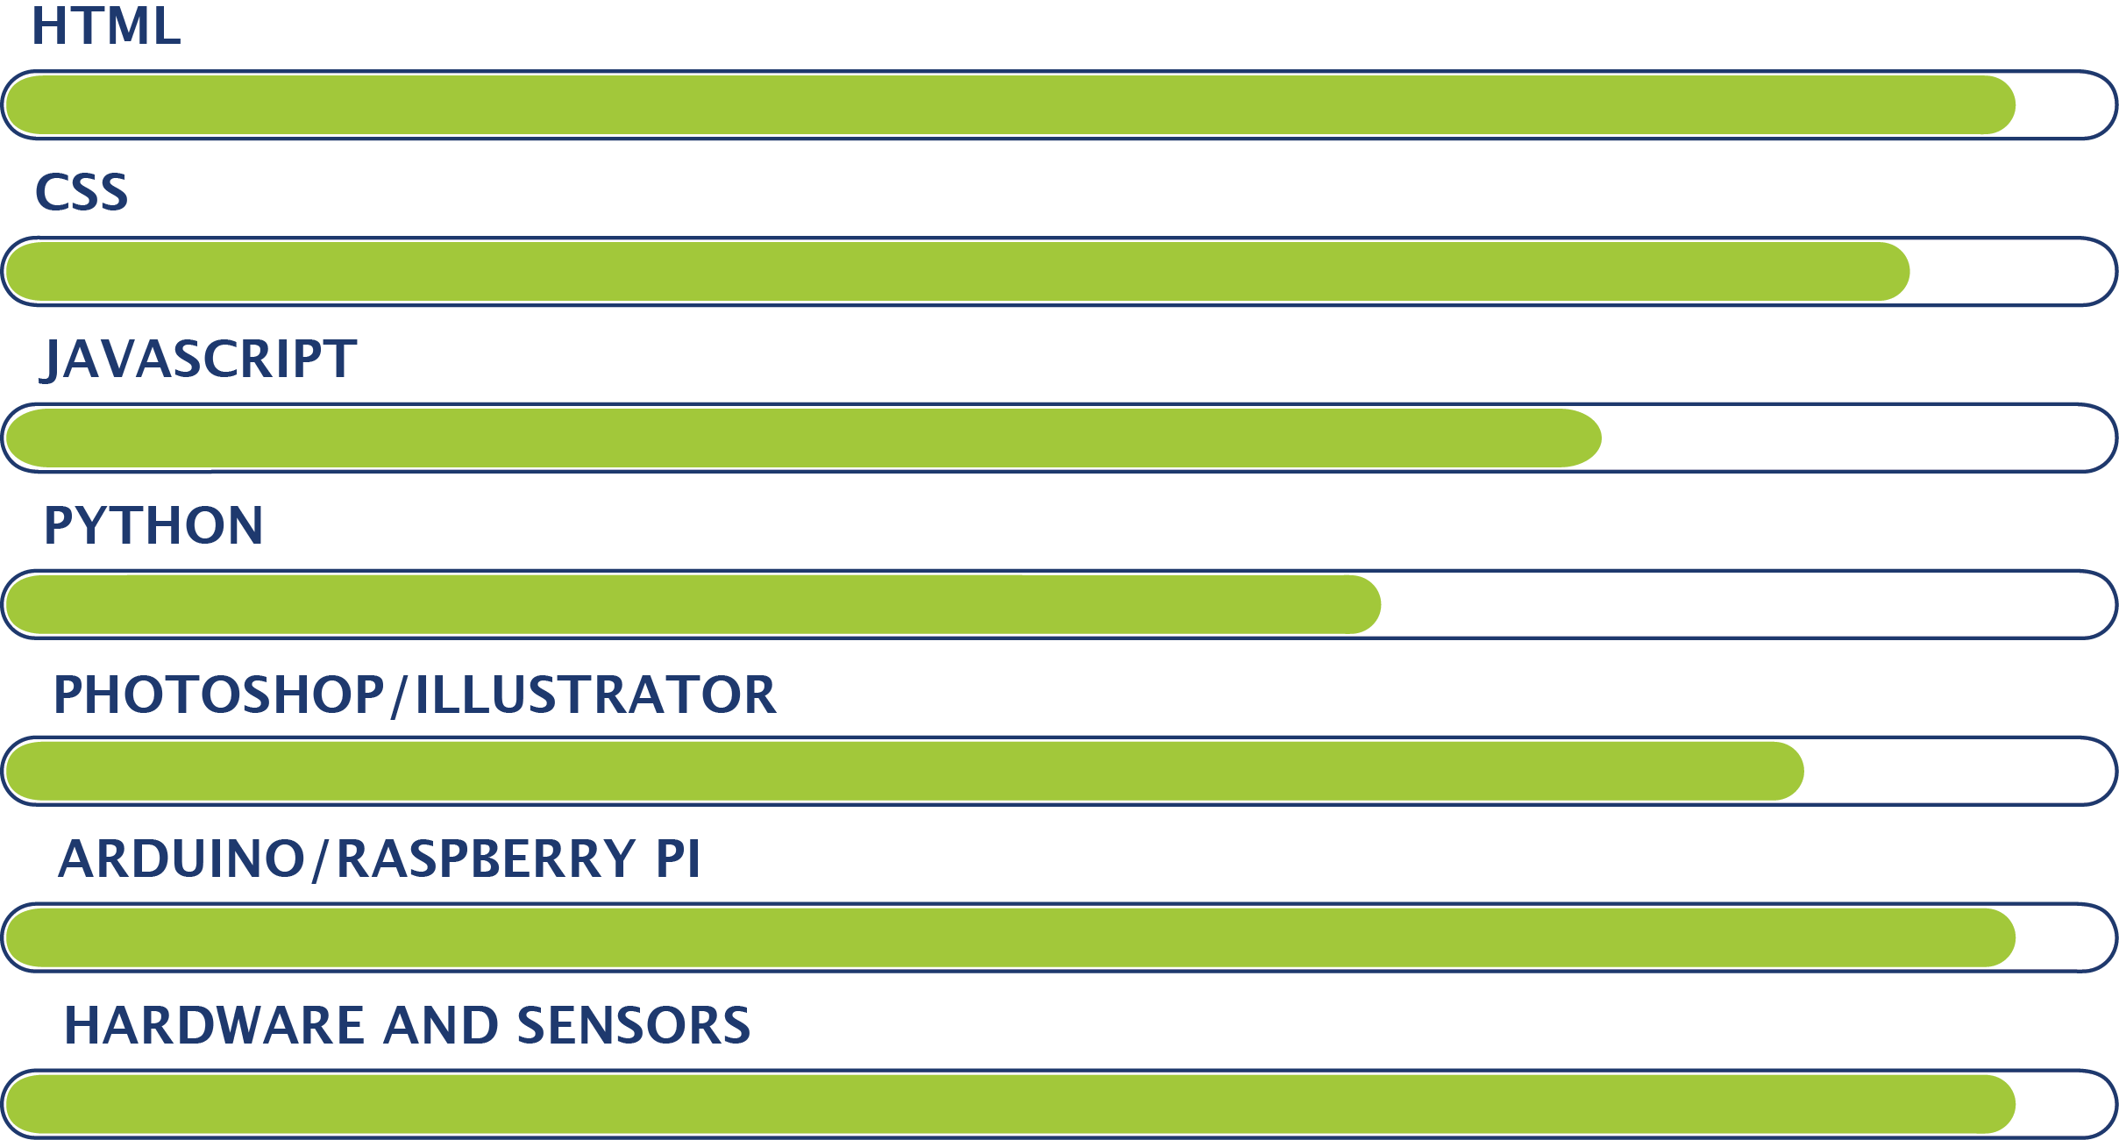
Skills needed for this project

Slide 4
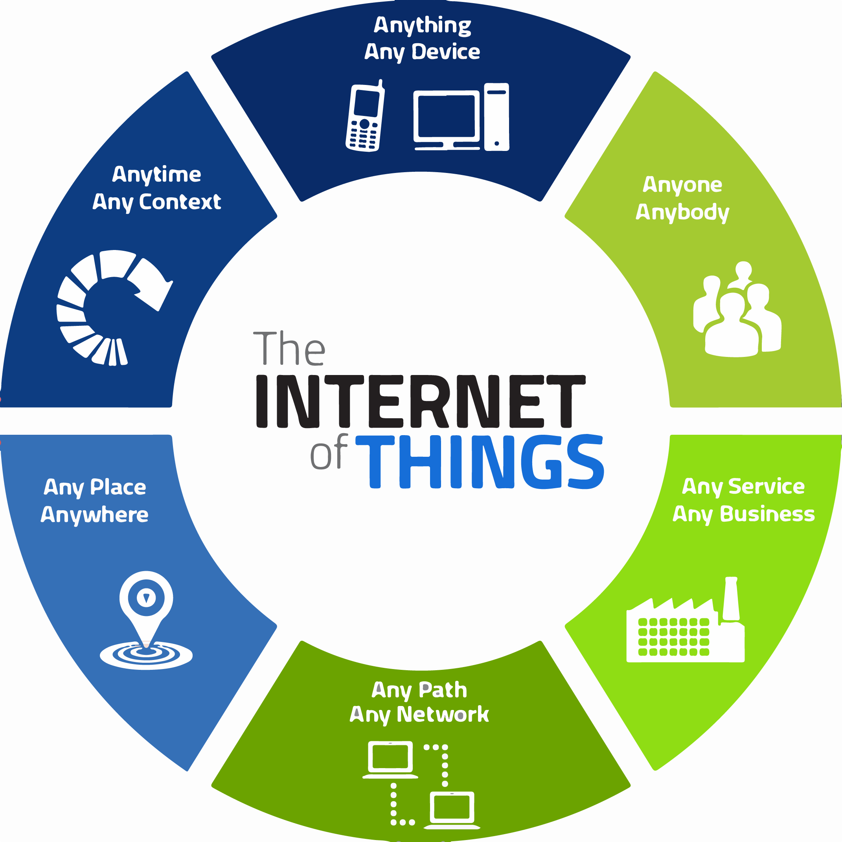
Internet of Things (IoT)

Slide 5
Internet of Things (IoT)
IoT is a network of physical objects embedded with software, sensors, circuits and network connectivity.
The future of IoT is inspired by “everything that can be connected, will be connected”.
“Things” in IoT refers to a wide variety of devices such as home appliances, heart monitoring implants, automobile with built-in sensors, field operation devices etc.
Smart Home is one of the main applications of internet of things.

Slide 6
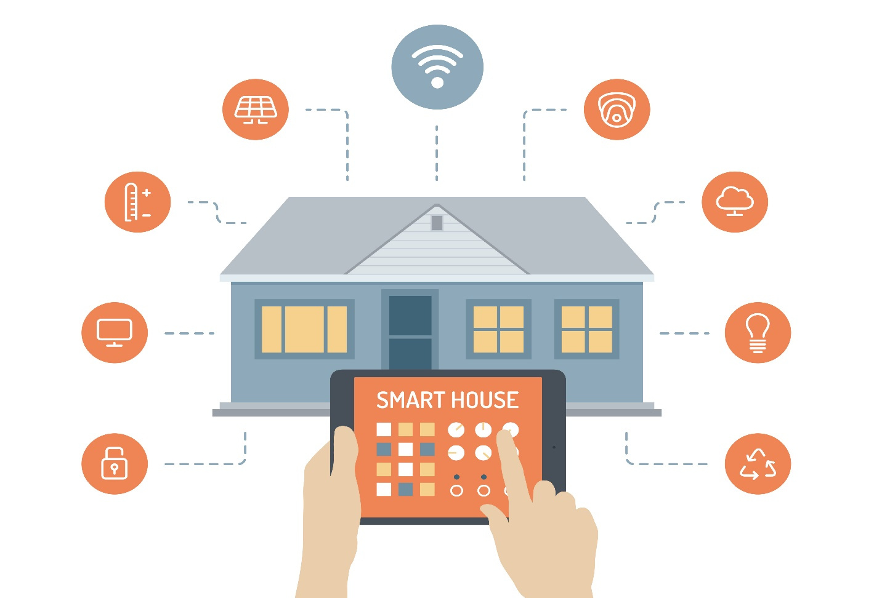
What is a Smart Home?
Courtesy: http://rethink-iot.com

Slide 7
Objectives of Smart Home
To securely connect everything in home to internet.
Bring your home to digital life and make day-to-day chores easier. Make your home a smarter place to live.
Optimally utilizing the available resources, which is imperative in present world.
Notes:
Connecting the dots wali phrase

Slide 8

Presenting to you.. SLAMS!

Slide 9
Intro to SLAMS!
SLAMS stands for Self-Learning Automated Monitoring System.
Self-learning: The system learns and adapts to user’s habits over time.
Automated: Various things and appliances in home are controlled using web portal and mobile application.
Monitoring: Things like doors, air quality, temperature etc. can be monitored using a system comprised of variety of sensors.

Slide 10
Features
Light and fan control
Health Care
Automatic curtains
Door Security
Safety Features
Notes:
We have tried to touch every aspect of life ranging from

Slide 11

Automatic/Manual Transition
On/off switch control
Manual mode: User can manually control the settings of house.
Automatic mode:
Sensors calibrate the settings automatically.
User gets updates as notification on mobile app.

Slide 12
Secure Login Page
The webpage has a login page with username and password for each user.
This ensures that unauthorized access does not take place and unknown person does not take control of the house.

Slide 13
Control and Secure Remote Access
One of the most important features of a smart home.
The states of all appliances can be accessed and controlled remotely.
Zigbees are used for communications among the devices.

Slide 14
Door Security System
Secure mode can be turned on when the user goes out.
Notification is received when someone else trespasses the property.
Ultrasonic sensors are used for this purpose.
Notes:
Security is something that nobody wants to compromise.

Slide 15
Automatic Curtains
Curtains can be opened and closed using mobile app and web portal.
Curtains will open themselves when sunlight falls on the LDR sensor attached to window.
Curtains will automatically adjust according to different modes (further discussed in AI slide).

Slide 16
Fire Alarm
Fire alarm is implemented using LM-35 temperature sensor.
When temperature follows unusually abrupt pattern e.g. rise in temperature at high rate, then a notification is sent to the user.
A buzzer is also installed to ring loudly; in case of fire.

Slide 17
Air quality sensing
Monitors Carbon Dioxide (CO₂) levels in the house and displays in the app.
The levels are analyzed against global CO₂ levels and user is notified in case of significant difference.
The user is also notified if CO₂ above the safe levels.

Slide 18

Temperature and humidity
The temperature and humidity in the house is continuously monitored
The readings are accessible to the user via app.
User is notified in case of sudden temperature change.

Slide 19
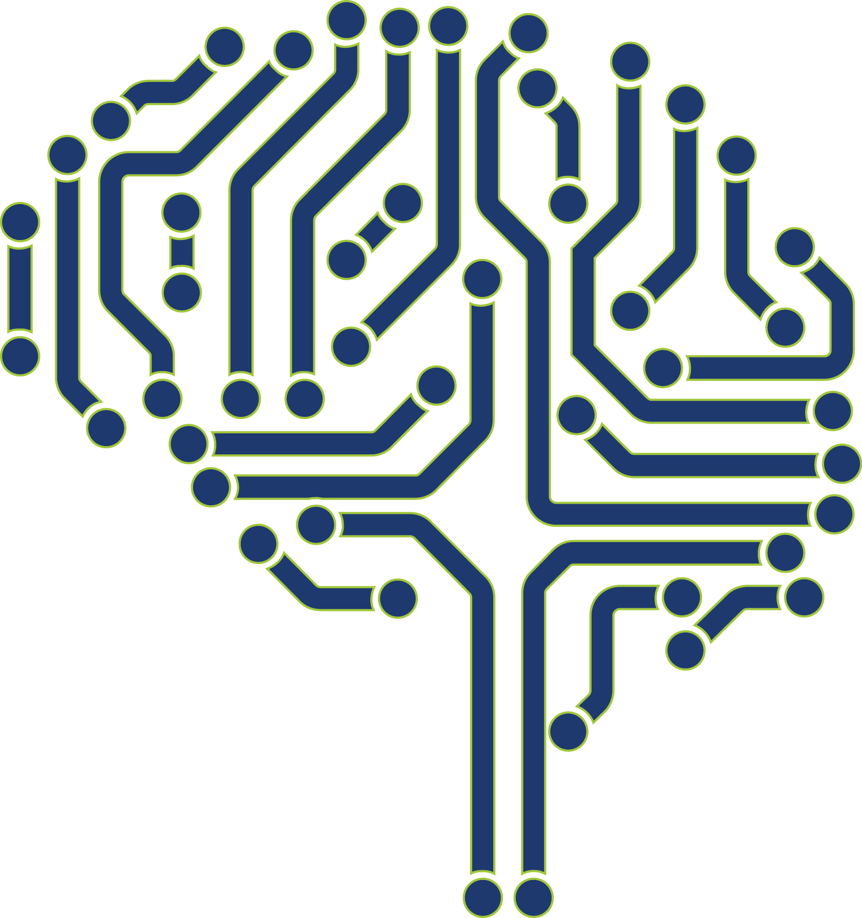
Artificial Intelligent System
The system uses machine learning to learn the habits of the users in home.
After a certain time, enough learning occurs to suggest various settings to the users (e.g. speed of the fan).
Suggestions are given to the user, whether to open curtains depending on the outside conditions.

Slide 20
Automated Servers
If the power disrupts, the server restarts from the same state that it was previously at.
The server saves the latest data it receives in the database(MySQL) and restores it when it regains power.
Notes:
Server will start again without any loss of data and manual effort.

Slide 21
Web security
Whenever a device is connected through Wi-Fi, its mac address is noted and saved.
The user can mark familiar devices and can block any mac address as needed.
System shows last seen time for different devices.
Online/offline status of currently connected devices is available.

Slide 22
SOS button
SOS button is the International Morse Code distress signal.
On pressing this button, all the other users will get a notification informing about the situation of emergency.
Notification is of the format: “Amit needs help at (‘latitude’, ‘longitude’)”.
Modern apps such as Apple Maps and Google Maps can visually show the exact location using coordinates.

Slide 23
Modes
Movie Mode
Sleep Mode
Turns off the lights, closes curtains and turns on door security making user comfortable and forget the tiredness of the day
Away Mode
Turn off every appliance and switch on the door security system
Morning Mode
Open curtains, turn on lights allowing for a fresh start of the day
Turns off the lights, closes curtains and makes perfect environment for watching a movie

Slide 24
Present Limitations
Air quality sensors (MQ135) are capable of measuring benzene, alcohol, ammonia, etc. But we have used it for CO₂ only.
After switching from manual mode to automatic mode, all the appliances switch-off and have to be started again (bug).
Switching modes is possible only through mobile or web. So if these are inaccessible, the user becomes helpless.
Data in the website does not update dynamically. We have to refresh the page to see the new data.

Slide 25
Future Prospect
Using face-mapping technique, our system can learn different habits of different users in home and adapting home according to different users.
Face-mapping can also be integrated for security and tresspassing purposes.
Usage of various appliances can be monitored for any time period.
Cameras can be installed in smart home and using that we can directly monitor the house using your phone or laptop no matter where you are.
Using voice assistant like Amazon Echo, Siri, etc. to control all the devices which are interconnected to grid.

Slide 26
Future Prospective
Backup power can be provided to servers and door security system so that in case if MCB is turned-off; even then security if home won’t be compromised.
Using voltage, current and power profile of different devices, we can remotely see which device is connected to a particular switch and that can be turned-off.
Number of people can be counted in a room and appliances will automatically turn-off after a specific period of time if no one is present.

Slide 27
Thank You !
“
The Internet of Things has the potential to change the world, just as the Internet did. Maybe even more so.
- Kevin Ashton, MIT
“
This presentation bears an imprint of many people,
we sincerely thank them for their support:
Padmanabh Pande, Paras Mehandiratta and Advait Vaidya

